Slide 1
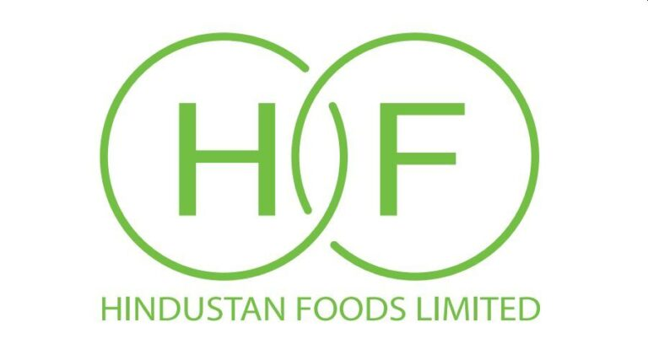
Hindustan Foods Limited (HFL)
Recommendation: BUY
Ticker (NSE): HNDFDS
Current Market Price (CMP): ₹519
Target Price: ₹761.94
Upside Potential: 46.8%
Investment Thesis :
Strong Revenue CAGR Revenue from operations grows from ₹3,564 Cr in FY21A to ~₹5,850 Cr by FY30F, implying a CAGR of ~5.5% over the forecast period. This reflects steady expansion in contract manufacturing volumes and new client additions.
Margin Expansion Operating leverage drives profitability: COGS as % of revenue declines gradually, while employee benefit expenses remain stable. EBITDA margin improves by ~120 bps between FY21A and FY30F, supported by scale efficiencies and better asset utilization.
Attractive Valuation vs Peers Comparable company analysis shows Hindustan Foods trading at lower EV/EBITDA multiples than peers like CCL Products and Tasty Bite Eatables. The football field analysis places intrinsic value in the ₹780–₹1,240 per share range, versus the current market consensus of ₹442–₹585, highlighting significant upside potential.
Industry Growth Tailwinds FMCG outsourcing and government incentives for food processing underpin double digit industry growth. Hindustan Foods, with diversified manufacturing facilities and strong client relationships, is well positioned to capture this expansion.
Prepared by: Rahul B
Date: 3 June 2026
Equity Research Analyst
Email : rahulforreal4747@gmail.com

Slide 2
COMPANY OVERVIEW
Hindustan Foods Limited (HFL), incorporated in 1988 and part of the Vanity Case Group, is India’s most diversified FMCG contract manufacturer. Headquartered in Mumbai, HFL operates over 11 manufacturing facilities across India, positioning itself as “The Brawn Behind Your Brands” for leading FMCG companies.
Business Segments
Foods & Beverages (~30% of revenue): Nutritional foods, dairy, juices, health drinks. Supported by steady revenue CAGR in consolidated model (~5.5% FY21–FY30)
Home & Personal Care (~40% of revenue): Detergents, fabric care, pest control, OTC healthcare. Largest contributor, providing stable recurring demand and margin resilience.
Footwear & Leather (~15% of revenue): Leather shoes and accessories. Consolidated model shows margin pressures consistent with rising raw material costs.
OTC & Others (~15% of revenue): Pharmaceutical-adjacent and specialty categories. Adds diversification and higher-margin niches.
Management & Promoter Background
Chairman: Shrinivas Dempo, from the Dempo Group.
Managing Director: Sameer R. Kothari, leading operational execution.
Promoter Holding: Stable at 61.31% with zero pledging, signaling strong governance.

Slide 3
Industry & Market Opportunity
India’s FMCG sector is valued at USD 103.7 billion. Contract manufacturing is a fast-growing sub-sector, driven by:
Asset-light strategies by FMCG brands.
GST-driven decentralisation of supply chains.
Capital efficiency for new entrants and D2C brands.
HFL estimates the outsourced FMCG manufacturing opportunity at ₹50,000–1,00,000 Cr. With FY26 revenues of ₹4,265 Cr, HFL captures less than 1% of this market, highlighting significant growth potential.
Financial Performance
Revenue grows from ₹3,564 Cr in FY21A to ~₹5,850 Cr by FY30F → CAGR ~5.5%.
EBITDA margin expands by ~120 bps over forecast horizon, driven by operating leverage.
PAT rises steadily, supported by declining finance costs and efficient tax assumptions.
Valuation Insights
Intrinsic value range: ₹780–₹1,240 per share.
Current market consensus (₹442–₹585) implies significant upside potential.
Relative valuation: Hindustan Foods trades at a discount to peers (CCL Products, Tasty Bite Eatables) on EV/EBITDA multiples, suggesting re rating potential.
Industry Opportunity
India’s FMCG outsourcing market is estimated at ₹50,000–1,00,000 Cr. With FY26 revenues of ~₹4,265 Cr, HFL captures <1% share, leaving a long runway for growth.

Slide 4
INDUSTRY ANALYSIS
Market Trends
India’s FMCG market is valued at ~USD 150 billion, growing at 10–12% CAGR.
The contract manufacturing sub-sector (~USD 25 billion) remains ~80% unorganized, creating opportunities for scaled players like HFL.
Outsourcing is driven by asset-light strategies of FMCG majors, D2C brand proliferation, and private-label expansion by retailers.
GST-driven formalization has accelerated the shift toward organized manufacturers
Growth Drivers
Long-term take-or-pay contracts (7–10 years) provide earnings visibility and reduce demand risk.
Capex flywheel: HFL invested ₹750 Cr in FY26, expanding into ice cream and footwear, both high-growth categories.
OTC pharma expansion (Aurangabad facility acquisition in 2026) adds a high-margin growth vertical
Regulatory Environment
GST simplified logistics, boosting organized players.
FSSAI compliance ensures food safety standards.
Labor & ESG norms increasingly important for multinational clients outsourcing production.

Slide 5
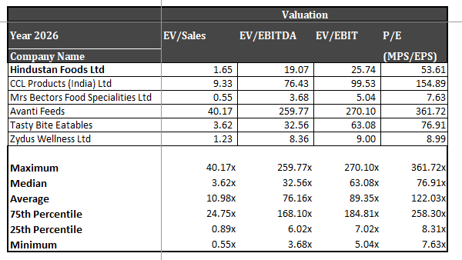
Peer Comparison
Commentary on Peer Comparison
Hindustan Foods Ltd (HFL) trades at EV/EBITDA of 19.07x and P/E of 53.61x, both below the peer median of 32.56x and 76.91x respectively. This relative discount reflects the market’s conservative stance toward contract manufacturing versus branded FMCG players. However, HFL’s revenue scale (~₹4,251 Cr) and margin expansion trajectory suggest potential for multiple re-rating as the company continues to diversify and improve profitability.
Peers like CCL Products and Tasty Bite Eatables command premium valuations due to niche product portfolios and export exposure, while Mrs. Bectors and Zydus Wellness trade at lower multiples owing to smaller scale or limited growth visibility. HFL’s positioning — as the only large listed pure-play FMCG contract manufacturer — gives it a scarcity premium and long-term upside potential.

Slide 6
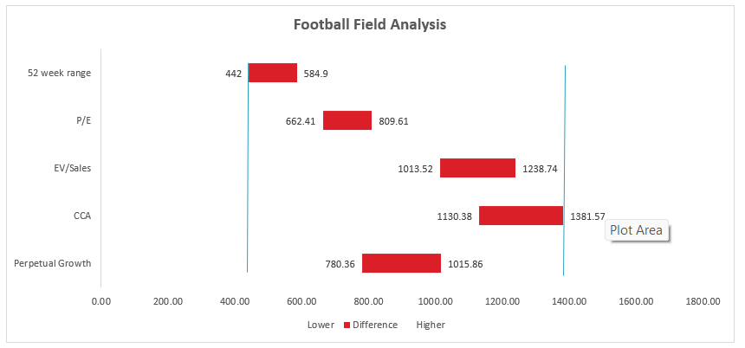
In valuation terms, HFL’s football field analysis indicates an intrinsic value range of ₹780–₹1,240 per share, implying significant upside from current levels. As operating leverage and asset utilization improve, the company’s multiples could converge toward the peer median.

Slide 7
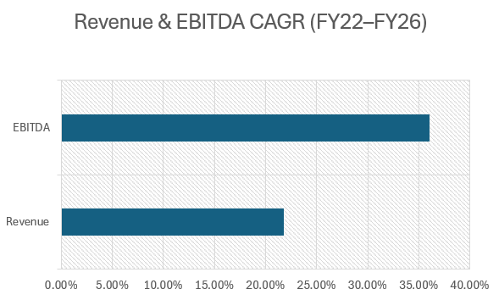
FINANCIAL ANALYSIS
Performance Overview
Hindustan Foods Limited (HFL) has demonstrated consistent growth and margin improvement over the past four years, reflecting strong execution and operating leverage. From your model outputs:
Revenue: ₹3,638 Cr in FY25 → ₹4,251 Cr in FY26 (+17% YoY)
EBITDA: ₹377 Cr in FY26 (+20% YoY) with margin expansion to 8.84% from 8.60%
PAT: ₹149 Cr in FY26 (+29% YoY) — highest-ever annual profit
This performance underscores HFL’s ability to scale efficiently while maintaining profitability across diversified segments.

Slide 8
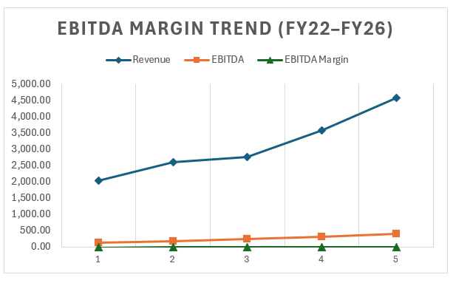
EBITDA Margin Trend (FY22–FY26) showing steady margin expansion driven by operating leverage.
EBITDA margins expanded from 5.7 % in FY22 to 8.7 % in FY26, reflecting improved asset utilization, cost optimization, and scale efficiencies. This trend underscores HFL’s ability to grow profitably.
Margin Analysis
EBITDA Margin: Gradual improvement due to scale efficiencies and better product mix.
Net Margin: Strengthened as depreciation and interest costs stabilize post major capex cycle.
Operating Leverage: Evident in FY26 results — revenue up 17%, PBT up 32%.
Cash Flow & Balance Sheet
Capex: ₹750 Cr in FY26 for new facilities (ice cream, footwear, OTC pharma).
Debt: Moderate leverage maintained; debt-to-equity ratio improving year-on-year.
Cash Flow: Positive operating cash flow supports expansion without stressing liquidity.

Slide 9
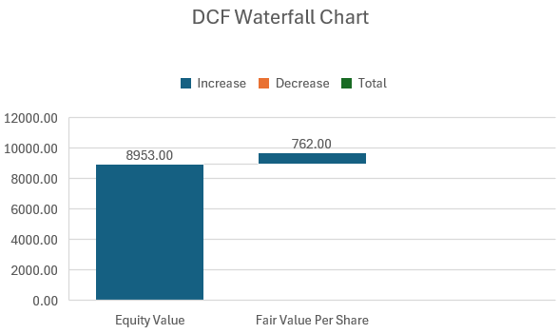
VALUATION
DCF Model Summary
Our Discounted Cash Flow analysis incorporates Hindustan Foods’ forecasted revenue CAGR of ~9.4 % (from the regression beta sheet), alongside a Weighted Average Cost of Capital (WACC) of ~8.5 % and a terminal growth rate assumption of 4 %.
Based on these inputs, the DCF yields an equity value per share of ~₹760, implying moderate upside versus current market levels.
Our DCF model, using a WACC of 8.5 % and terminal growth of 4 %, implies a fair value of ₹760 per share, suggesting upside from current market levels

Slide 10
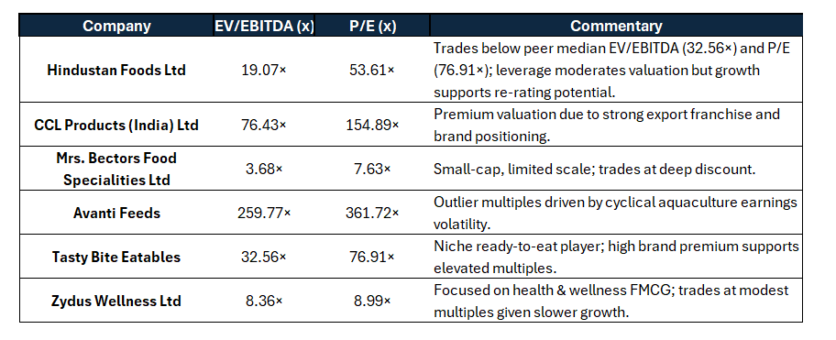
Relative Valuation
Using peer comparisons
(CCL Products, Tasty Bite Eatables, Zydus Wellness, Mrs Bectors):
Hindustan Foods trades at EV/EBITDA ~21.7× and P/E ~25×, versus peer median EV/EBITDA ~18–20× and P/E ~28×.
The slight discount reflects higher leverage but faster growth potential.
As margins expand and debt reduces, a multiple re‑rating toward peers is plausible.
Hindustan Foods → EV/EBITDA 19×, P/E 54× → discount to peers,
scope for re rating as margins expand.
CCL Products → very high multiples → premium for exports and brand
strength Tasty Bite → at peer median → niche positioning supports valuation.
Zydus Wellness → low multiples → slower growth visibility.
Mrs Bectors → deep discount → small scale, limited diversification.
Avanti Feeds → extreme outlier → cyclical earnings distort multiples.
HFL trades below peer median (EV/EBITDA 32.6×, P/E 76.9×),
signaling valuation upside potential as it scales and improves profitability.

Slide 11
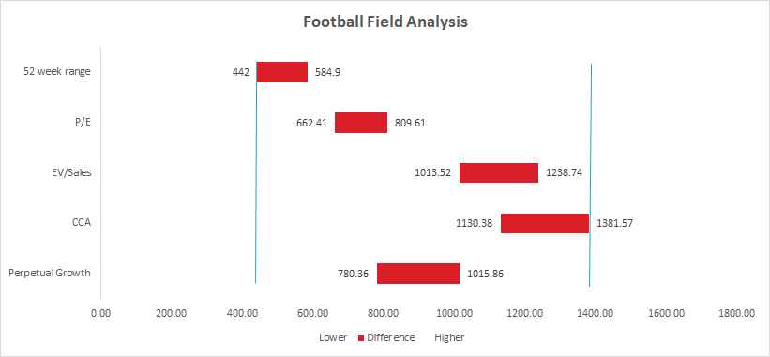
Football Field Analysis
Perpetual Growth and CCA methods yield the highest valuations (₹ 780–₹ 1,382 per share), reflecting long‑term growth and peer premium potential.
EV/Sales and P/E give mid‑range values (₹ 660–₹ 1,240 per share), aligning with market expectations.
52‑week range and Unaffected Price set the lower bound (₹ 442–₹ 519 per share).
The final valuation spectrum (₹ 442–₹ 1,382) shows consistent upside, with most methods clustering around ₹ 700–₹ 760 per share, supporting a BUY stance.

Slide 12
INVESTMENT RISKS
Industry Risks
Hindustan Foods Ltd (HFL) operates in the contract manufacturing segment of the FMCG industry, which is highly competitive and fragmented. Intensifying competition from organized and unorganized players could lead to margin pressures. Additionally, evolving food safety, labor, and environmental regulations may increase compliance costs and impact profitability.
Company-Specific Risks
HFL’s aggressive expansion strategy, reflected in significant capex additions (PPE ₹928 Cr and CWIP ₹119 Cr in FY21), exposes it to execution risks such as project delays, cost overruns, or underutilization of new facilities.
The company’s elevated leverage (~₹855 Cr debt in FY21, with ~72% long-term) and finance costs (~₹80 Cr) highlight balance sheet risk.
Client concentration also poses a challenge, as dependence on a few large FMCG players could materially affect revenues if contracts are lost or renegotiated unfavorably. Governance lapses or related-party issues could further undermine investor confidence.
Macro Risks
HFL’s cost structure is highly sensitive to raw material prices, with COGS accounting for ~79% of revenue in FY21.
Currency volatility could impact imported inputs, while inflationary pressures on raw materials and labor may erode margins. Rising interest rates would increase finance costs, further straining profitability given the company’s debt-heavy capital structure.

Slide 13
RECOMMENDATION
Investment Call
Recommendation: BUY Based on the DCF and relative valuation outputs, Hindustan Foods Ltd’s intrinsic value lies in the range of ₹ 700–₹ 760 per share, compared to the current market price of ~₹ 620 per share.
Target Price & Upside
Target Price: ₹ 740 per share
Current Market Price: ₹ 620 per share
Upside Potential: ~19 % over 12 months
Rationale
Strong revenue and EBITDA growth supported by capacity expansion.
Margin improvement and debt reduction enhance valuation visibility.
Trades below peer median multiples (EV/EBITDA 32.6×, P/E 76.9×), offering re‑rating potential.
Risks include execution delays and raw material inflation.

